Slide 1
Opening a new shopping center in Auckland, New Zealand
IBM Applied Data Science Capstone
SAMIRA YADEGARI
DECEMBER 2020

Slide 2
Background Information
Shopping malls provide a great distribution channel for retailers to market their products and services
Property developers are taking advantage of this trend to build more shopping centers to answer to the demands
And
Auckland is the biggest city in New Zealand also is a very big city
Auckland has high traffic jam
Auckland has an annual population increase

Slide 3
Business Problem
If the city authorities are looking to open a new shopping center,
where is the best place for that?

Slide 4
Data Resources
List of neighborhoods in Auckland, New Zealand is fetched from Wikipedia page (https://en.wikipedia.org/wiki/Demographics_of_Auckland).
For achieving geographical (Latitude and longitude) coordinates of the Auckland neighborhoods we use the Python Geocoder package.
Venue data, particularly data related to shopping malls will extract from Foursquare API

Slide 5
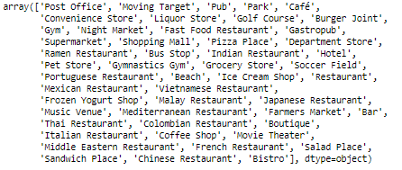
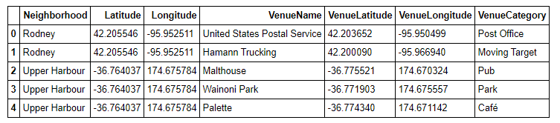
Neighborhoods Analysis
Extract the list of categories by
using the Foursquare API.
Extract Auckland neighborhood venues list by using the
Foursquare API.

Slide 6
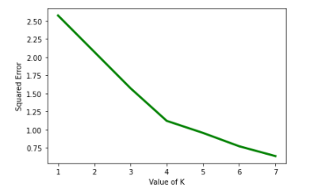
Neighborhoods Clustering
we will perform clustering on the data by using k-means clustering.
Elbow method is used for identifying the best number of clusters and it showed K=4 is the best for our clustering.

Slide 7
Neighborhoods Clustering
Cluster 0: Neighborhoods with a moderate number of shopping malls
Cluster 1: Neighborhoods with a high concentration of shopping malls
Cluster 2: Neighborhoods without shopping malls
Cluster 3: Neighborhoods with less than a moderate number of shopping malls

Slide 8
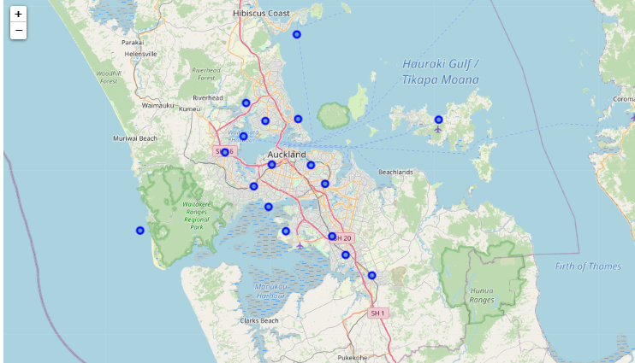
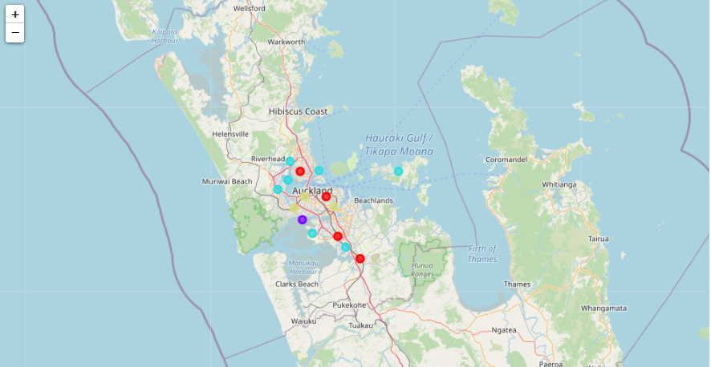
Neighborhood clustering
Map
Clustered Map

Slide 9
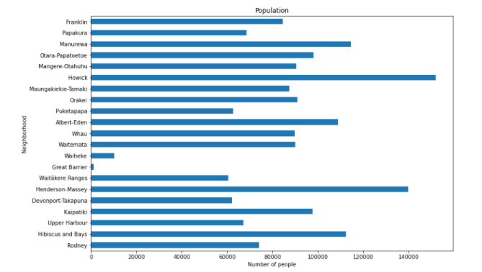
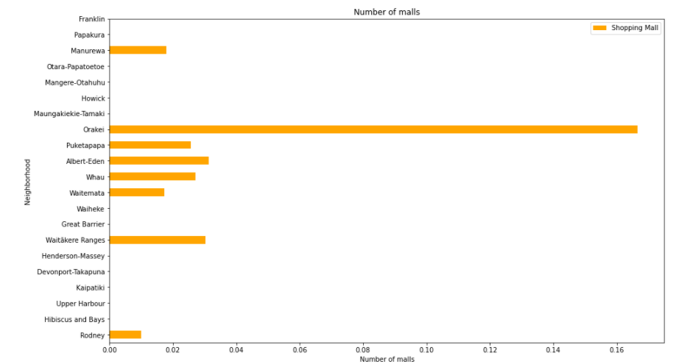
Comparisons
Neighborhoods and population
Neighborhoods and shopping mall numbers

Slide 10
Conclusions
After, extracting and preparing the data, performing machine learning by clustering the data into 4 clusters based on their similarities.
The neighborhoods in cluster 2 are the most preferred locations to open a new shopping mall, although looking at the population of those neighborhoods and their distance to other shopping malls are two important factors to consider too.
The findings of this project will help the relevant stakeholders to capitalize on the opportunities in high potential locations while avoiding overcrowded areas in their decisions to open a new shopping mall.

